Slide 1

Enterprise groupware computing solution with engagement
AMC Engineering College Bangalore
Master of Computer Application
2021
Submitted By: Faizan Khan
(1AM18MCA01)

Slide 2
Presentation Agenda
-Project Overview/Scope And Objective
-Problem Statement
-Project Metrics
-Existing System
-Objective of the Proposed System
-Review Of Literation
-System Configuration
-Project Deliverables
-Description of 3rd Party Software Packages used
-Software Development Model
-System Design (Architectural and Detailed)
-Expected Outcome Of The Proposed System
^System Demonstration
-Results And Discussion
References

Slide 3
Project Overview
Categories of Groupware product
Email / Messaging
Group Calendaring and Scheduling
Conferencing products
Workflow tools
Group Document handling

Slide 4
Scope and Objective
System Associates with multiple type of fog computing methodologies
The system works on global scenario
Dynamic provisioning on-demand is supported within the system
Integrated dashboards will be available
Scalable infrastructure help the organization to manage various types of analytical activities, operational activities, and media oriented activities on a larger scale with Global reference
The main objective of the system is to consolidate single frame workability

Slide 5
Project Overview and Scope and Objective
User
Administrator
Associate
Scope and Objective
Multiple teams can be regulated at the same time and these teams will be having individual rights to access the system and this will be done by the control panel which will be accessible only to the administrator.

Slide 6
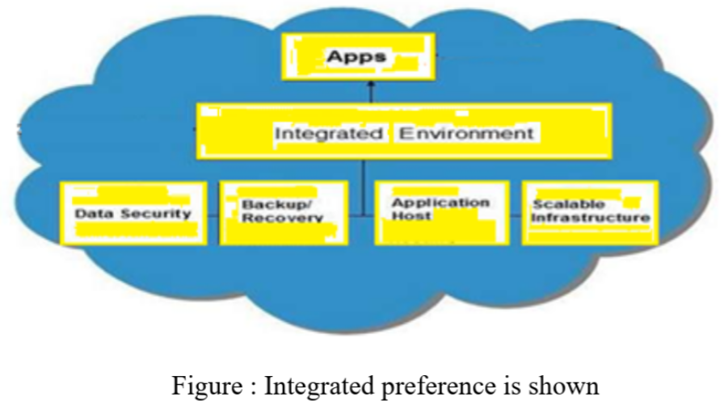
Scope and Objective
The scope of the system is that by incorporating different types of wizards the users can have multiple operations conducted at the same time and this will be helpful for the organizations those who want multiple types of business projections on a global scale
Other features…

Slide 7
Problem Statement
As the companies are working on a larger scale they have to manage media channels so the system provides multiple media channel integrations with various types of API and guidelines collections so that with proper authorization they can be controlled.
Providing multiple frame status is quite difficult
Providing various types of cloud references of resources
Provided objectives of the settings related to the analytics
The system also provides analytical information

Slide 8
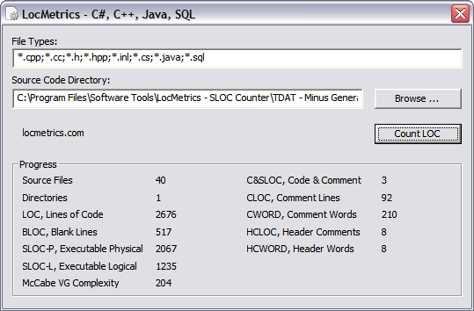
Project Metrics – Source Code
Some additional metrics
Number of OO-classes: 19
Number of Requirements: 22
Number of pages of source code (*.cs/*.h): 63

Slide 9
Existing System
In the existing system the integrated infrastructure
As multiple components are required for the environment setup
we do not have multiple parallel framework workability which makes the control quite difficult.
single Framework settings with multiple types

Slide 10
resources that are needed it's quite difficult in reference to the usage and accessibility control
The media integrated working is also quite important
Data management and user reference is also quiet difficult in existing system

Slide 11
Objective of the Proposed System
In the proposed system all type of skeletal workability is supported and different types of parallel environment
The scope of the system is that by incorporating different types of wizards
The main objective of the system is to consolidate single frame workability with all types of scalable references and all types of fog computing support.

Slide 12
REVIEW OF LITERATION
Each team and that will be performed within the system can also be defined with various types of backup system that will be directly integrated on a cloud platform
The system provides a distributed mechanism which will be helpful to control all perception work from a single system with different types of oriented guidelines according to the requirements.
companies are working on a larger scale they have to manage media channels so the system provides multiple media channel integrations with various types of API and guidelines collections.
Multiple channel accessibility will also provide the flexibility to the organization as a multi activity.

Slide 13
REVIEW OF LITERATION
Multiple channel accessibility will also provide the flexibility to the organization as a multi activity.
The system also provides analytical information which will be also based on rich site summary coding that will provide the users the required information related to the business plan perception.
Variation of the views are also supported within the system

Slide 14
FUNCTION REQUIREMENT
View Design
Use Case Name | View designs
Trigger | Settings
Precondition | Admin access required
Post-condition | Channels added
Process | Frame view designs and applicability of different types of environment Each frame design comes with settings User incorporation for particular page also require

Slide 15
FUNCTION REQUIREMENT
Knowledge Analytic
Use Case Name | Knowledge analytic
Trigger | Settings and input
Precondition | Authentication needed
Post-condition | Data reports provided
Process | Knowledge analytic we add Multiple subject will be added and accordingly the information will be retrieved.

Slide 16
FUNCTION REQUIREMENT
Technology-flexibility
Cross platform working with security consideration should be available for the effective trusted working
Virtualization support will be inherited as the same identity can be used by different companies at the same time
The selection of a particular identity should provide a scaling and structuring for the utility computing support
All critical structuring for various tools on a central Home screen system will be provided
Third party essentials will be integrated to provide the economic benefit to the users with consolidated working and control

Slide 17
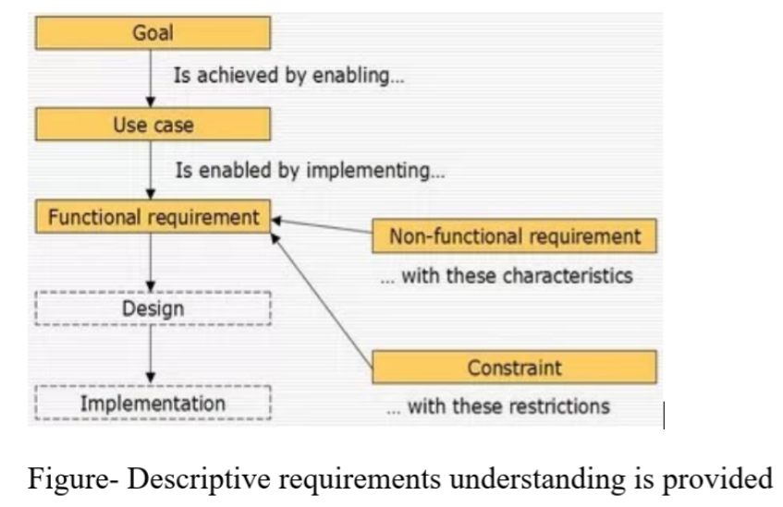
Nonfunction Requirement
Nonfunctional requirements will help to process the workability properly in the real-time
there for the users to understand the concept, scalability is provided to manage multiple projects

Slide 18
NON FUNCTION REQUIREMENT
Non-functional requirements
Non-functional requirements will help to process the workability properly in the real-time
Scalability
scalability is provided to manage multiple projects, the reason by the system is being designed for providing proper scalability to the users

Slide 19
SYSTEM CONFIGURATION
Hardware Requirement Components
Software Requirement Components
Computer processor
Clock speed
Hard Disk
Space RAM
4th generation Intel core i3
1.7 GHz
500GB
4GB
Cloud service integration

Slide 20
SYSTEM CONFIFURATION
Hardware Requirement Specification
Software Requirement -------------Specification
Windows
To handle C# code
To handle environment
To maintain database
Amazon S3 or EC2
Operating System
Visual studio 2019
NET Framework 4.7.1
Sql server 2014/Oracle
Cloud service integrations

Slide 21
Project Deliverables
Documentation
Project Proposal/Description Document
Concept of Operations (CONOPS) Document
Software Requirements Document
Project Management Plan Document
Architectural Function (High-Level) Design Document
Detailed Design Document
Nonfunctional Requirements
Scalability Plan Document Microsoft Visio
User’s Manual Document
Existing System Installation Document
Proposed System Requirements Document
Project Presentation Slides
Software
Visual studio to handle C# Source Code (*.cs/* files)
All Visual Studio Project Related Files
.NET Framework 4.7.1
Executable Program File and any Additional Dynamic Link Libraries (DLL)
Cloud service integration

Slide 22
3rd Party Software Packages
Qt
From Docker for Windows
Object-Oriented Visual Studio2017 package for GUI development
Open Source, freely available V 4.2.2 used
Qwt
ASP.NET MVC Application to Windows Containers
Extension of Qt that added ability to plot graphs
Open Source, freely available V 5.0.1 used
FFTW (Fast Fourier Transform of the West)
Available from MIT
C#-based library that assists with CLI computations/algorithms
Helped reduce Development risks, but introduced learning curve risk

Slide 23
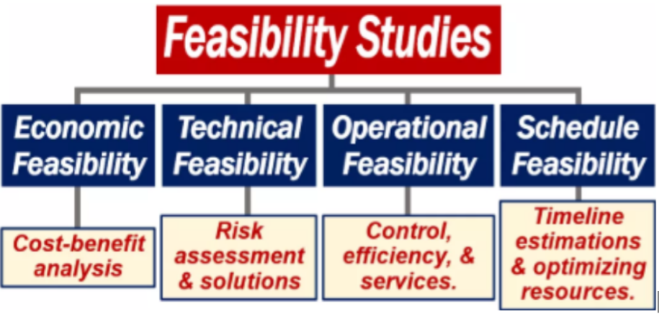
Software Development Model
Feasibility study
Technical projections will be undertaken within the feasibility study and even we will discuss that how the related operations in real time will be managed
Technical references are quite important to recognize
Integrates some aspects of Spiral

Slide 24
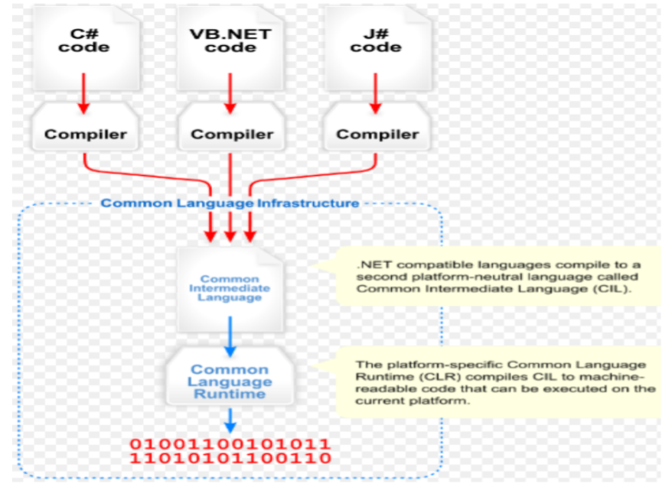
System Architecture Design – Package Diagram
ASP.NET MVC Application to Windows Containers

Slide 25
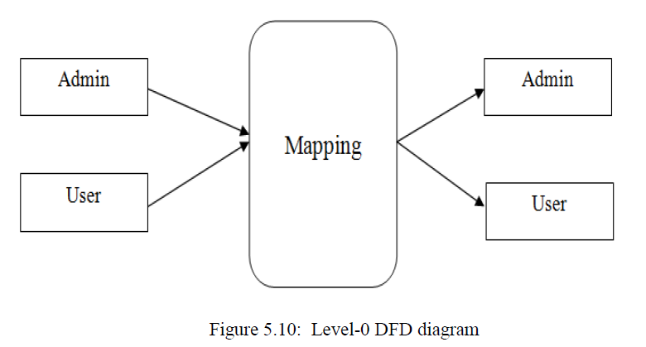
System Architecture Design – Use Case Model

Slide 26
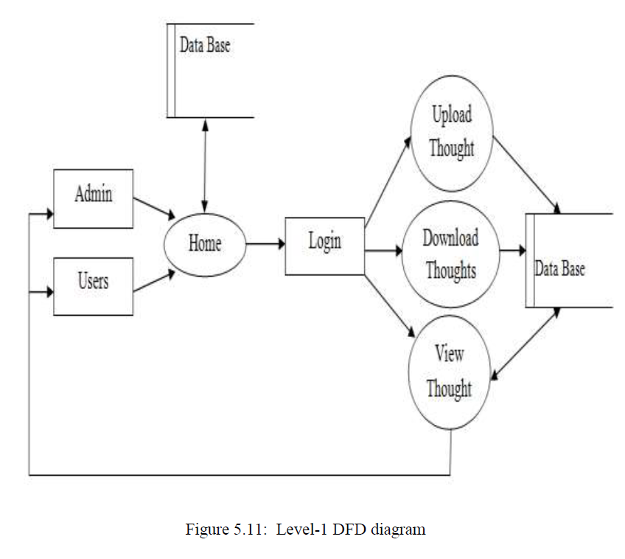
System Architecture Design – Use Case Model

Slide 27
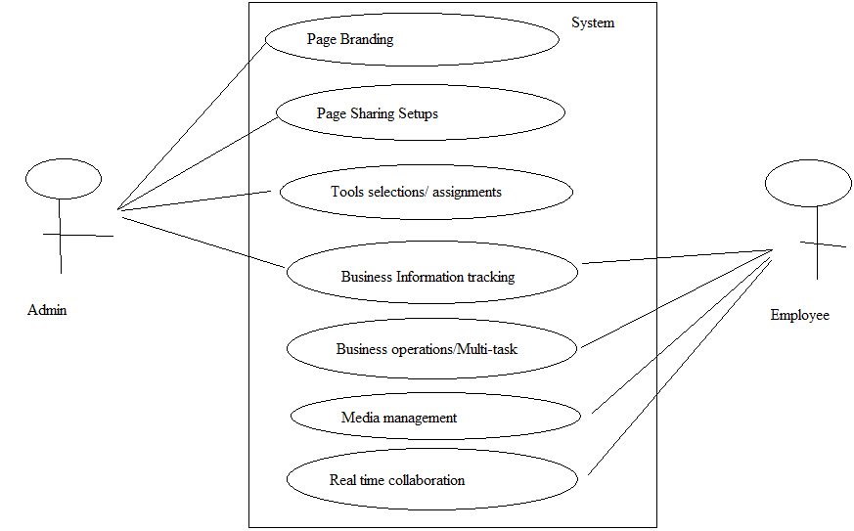
System Architecture Design – Subsystem Breakdown

Slide 28
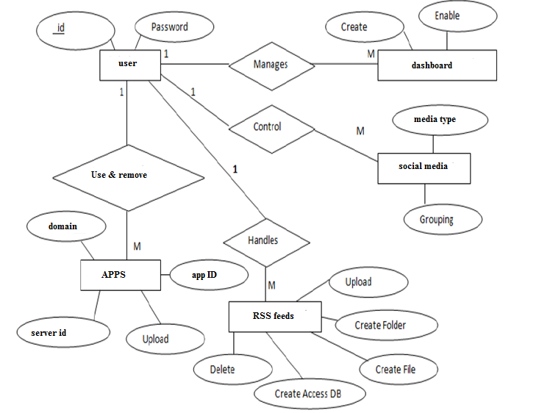

Slide 29
System Detailed Design - Strategy
Define the Static Model
Use UML Class Diagrams
Assign each class to a subsystem
Define inheritance, associative, and compositional relationships
Define methods
Define Dynamic Model
Use UML Sequence Diagrams
Create a Sequence Diagram for each Use Case
See Word document for a quick review

Slide 30
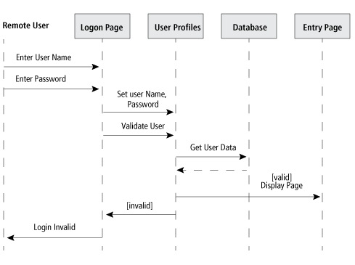
Sequence diagram

Slide 31
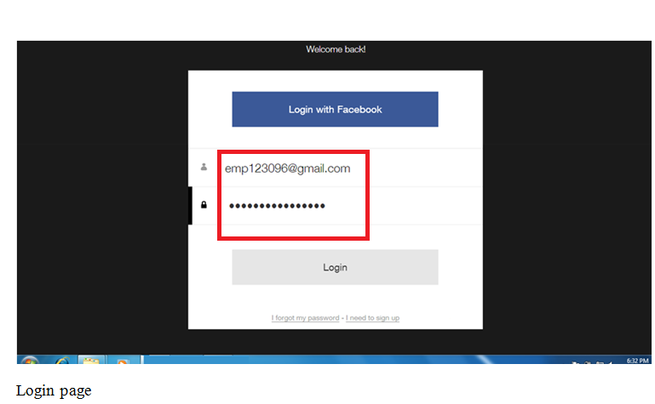
Expected Outcome Of The Proposed System or System demonstration

Slide 32
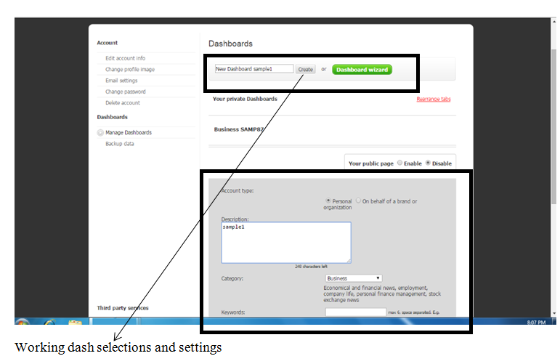

Slide 33
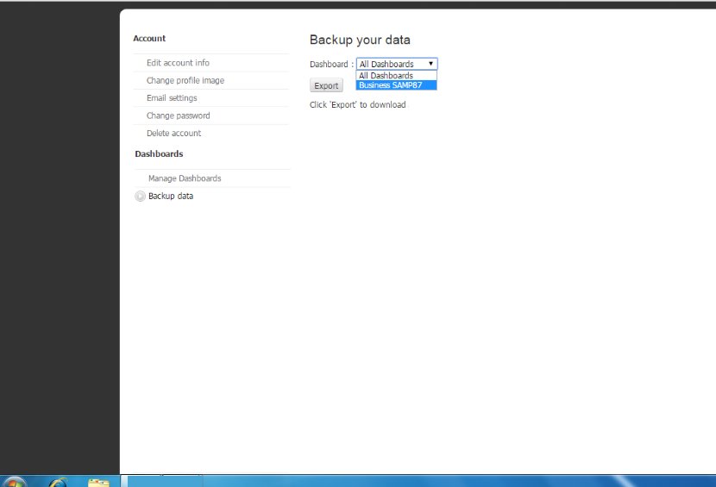
Backup

Slide 34
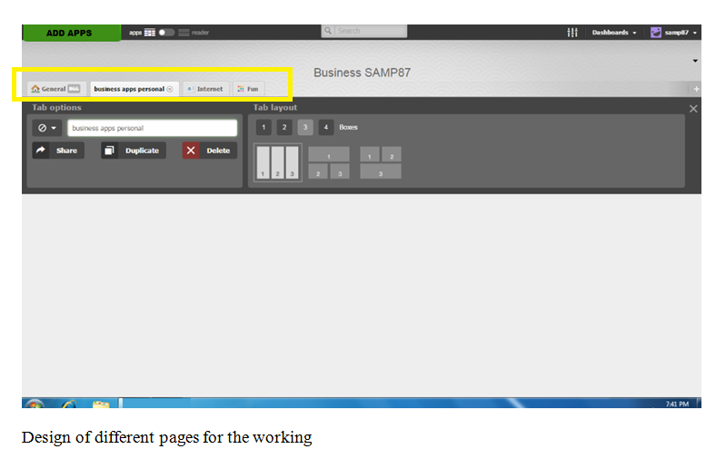

Slide 35
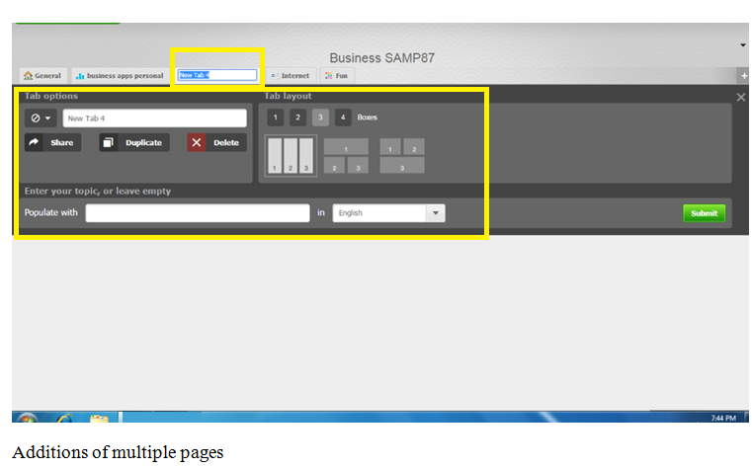

Slide 36
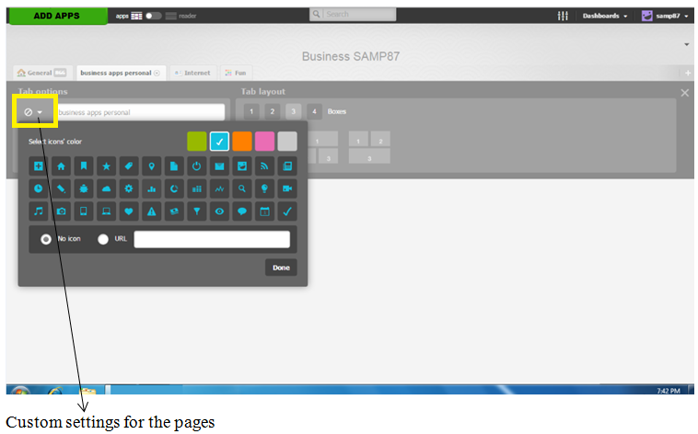

Slide 37
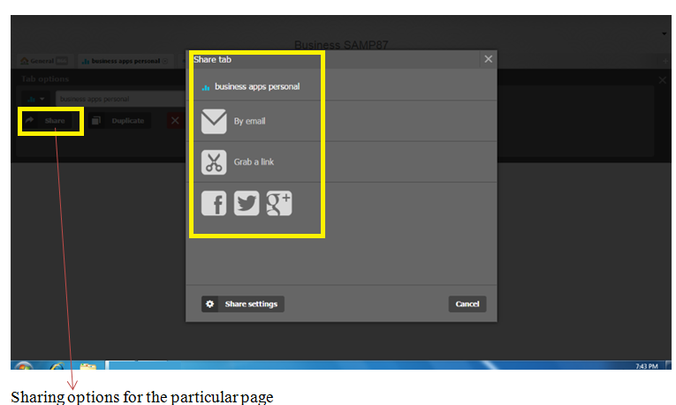

Slide 38
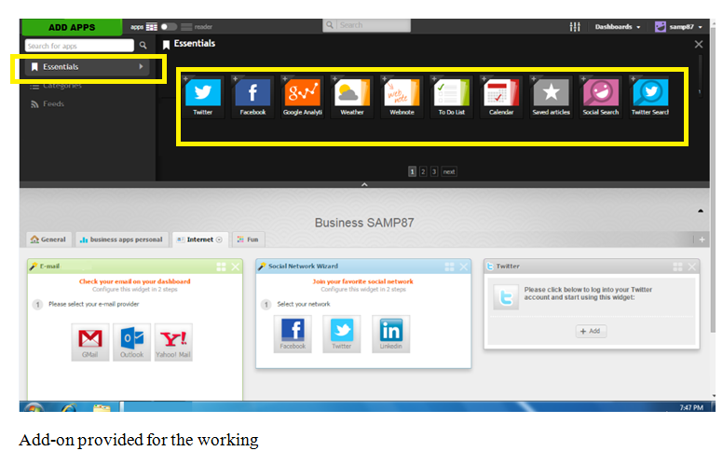

Slide 39
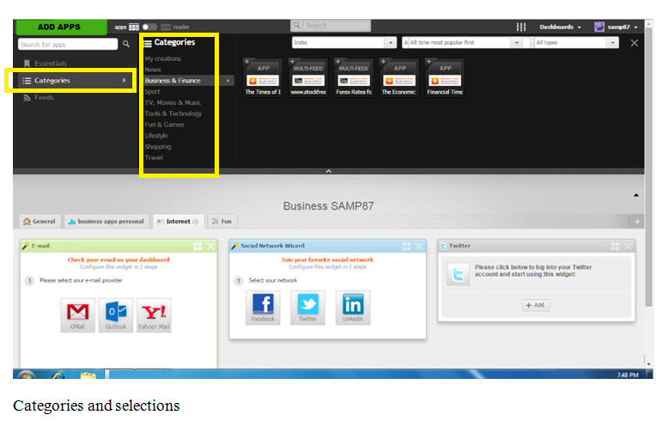

Slide 40
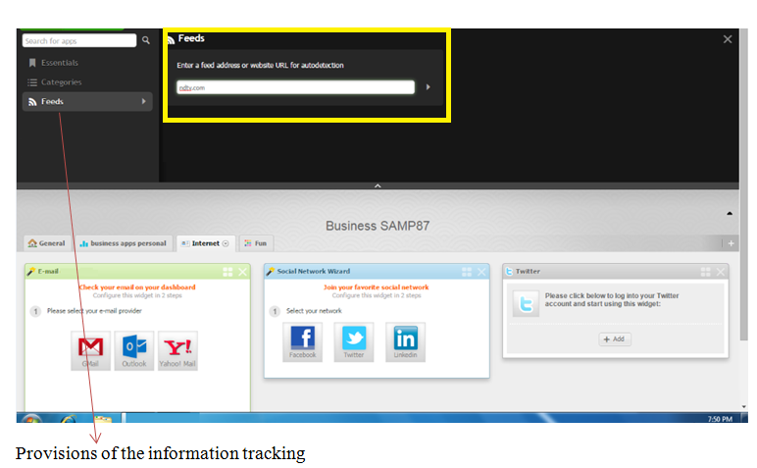

Slide 41
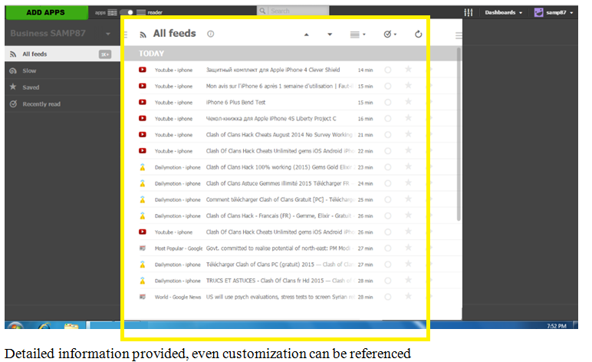

Slide 42
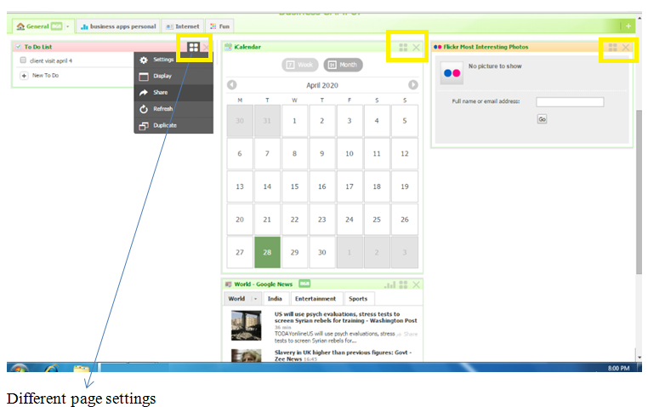

Slide 43
Results And Discussions
Conclusion
Regulation based multiple scenario accomplishments can be properly defined with the help of the system as when we have channel various types of pages
We have also acknowledged that each page that is being referenced can be channel with multiple settings and elaborated editing is provided for managing the considerations which is very much helpful.
As the users were added multiple mechanism for the invitations and for the authentications were also presented which is helpful

Slide 44
Limitations
The system includes the facility to arrange the work as required plus multiple activities can be organized to provide effective way to have all in one work review with a flexible time understanding. The accomplishment can be achieved with all authenticated users that can be clubbed to the system all the single workspace defined by the admin as multiple setup options will be provided to conclude the monitoring and work liability requirements. All factors are available to help the trade management in respect to the requirements of the resources are included.

Slide 45
Future Enhancement
Enhancement makes the system more compatible and directly implied the references for the usage provides more considerable Optimization in the future so we are regularly auditing the new requirements and accordingly the provisions will be added-
The most important reference that has to be channeled within the system is to provide the users with a set of new tools as it is required
More information channels in the compatibility to enhance more Complex data information can be added in the future and even if required more graphical display aspect can be added
Reports can be improved and more filters can be provided

Slide 46
References
Internet
Mr. Ganesh D (Team Lead)
Tangent ProBiz Bangalore
All equipment gadgets have setup settings that can influence execution and framework work.
Equipment design data may include:
Accessible memory
Power the board highlights
Gadgets that are associated, for example, modems, plate drives and sequential ports.

Slide 47
References
Text References
Operating System: Windows
Visual studio 2019: To handle C# code
NET Framework 4.7.1: To handle environment
Sql server 2014/Oracle: To maintain database
Cloud service integration- Amazon S3 or EC2
Web reference
www.scribd.com
www.wikipedia.com
https://www.techopedia.com//definition/29998/system-design
http://www.visual-paradigm.com/guide/data-flow-diagram

Slide 48
Comments
Thank you!..

